Slide 2
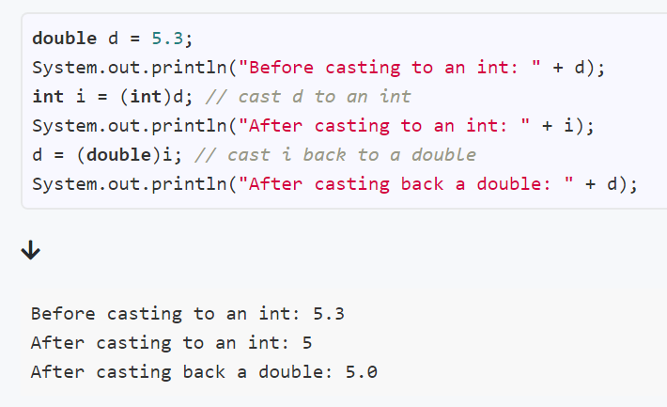
Casting primitives
Casting = changing the type

Slide 3
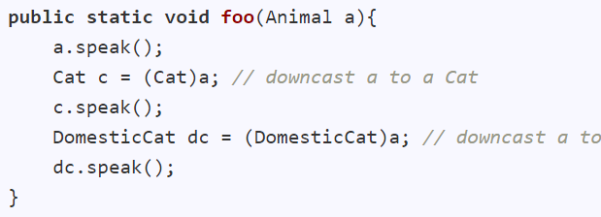
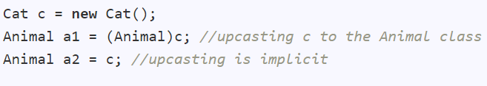
Casting object references
Animal
Downcasting: from superclass to subclass
Cat
DomesticCat
Upcasting: from subclass to superclass. Implicit.

Slide 4
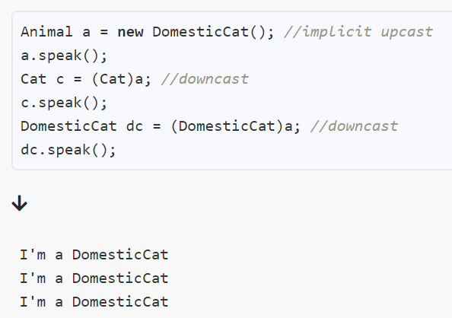
Casting and polymorphism
Animal
Object behaves according to actual type, not reference type
(as per polymorphism)
Cat
DomesticCat

Slide 5
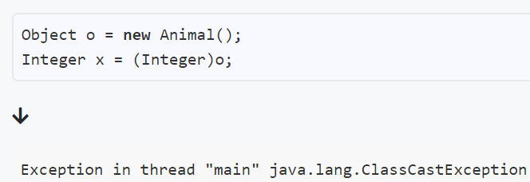
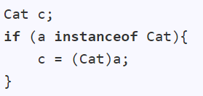
ClassCastException
Casting between incompatible types:
Can happen when downcasting as well
Checking the type before casting:

Slide 7
Packages
Organize related classes and interfaces
Avoid name conflicts
Easy management

Slide 8
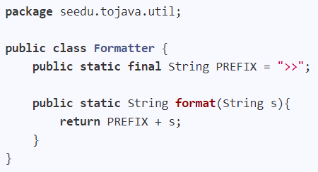

Java packages: creating
At the top of every source file in that package
Folder structure should match

Slide 9
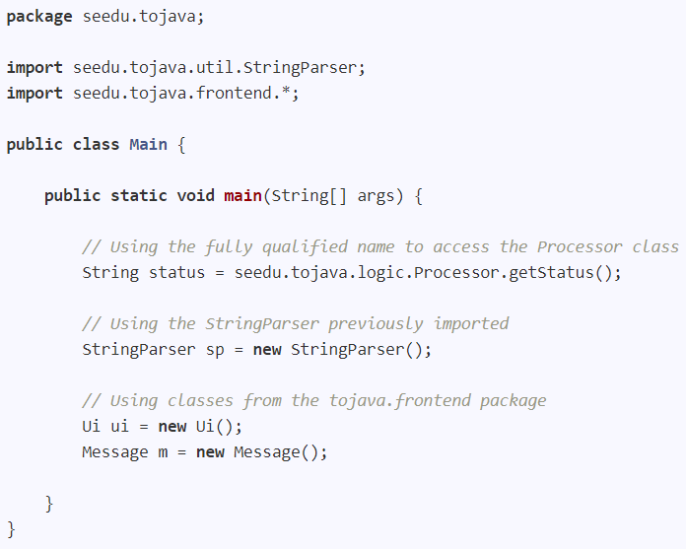
Java packages: using
Import one type (class, interface, enum)
Import all types in package
Use without importing

Slide 10
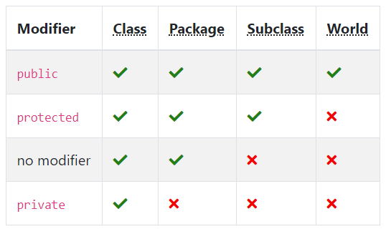
Access modifiers
aka package-private

